Slide 1
Quantum Masters Week 4
Lucy and Eva

Slide 2
Quantum Algorithms
Why?
Superposition allows us to compute in more states at once
Entanglement can let us transfer information across any distance
Example:
Quantum teleportation: can transfer one qubit state using two entangled qubits and two classical bits
Drawbacks:
Although superposition allows computation in parallel, the state still must collapse into classical states in order to be used

Slide 3
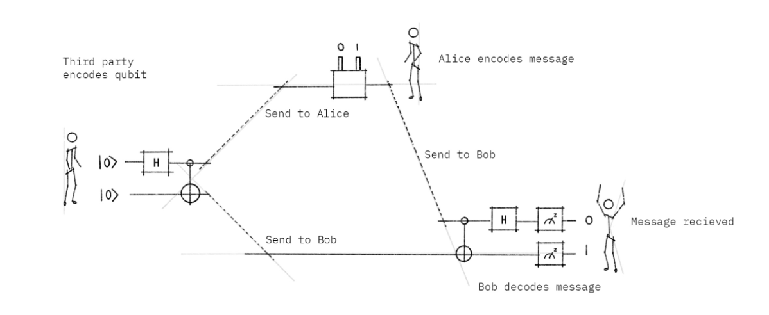
Super-Dense Coding
This is a protocol that uses entangled qubits to transfer two classical bits of information by sending one qubit
This is almost like the ‘reverse’ of the quantum teleportation protocol, which uses two classical bits to transfer a quantum state

Slide 4
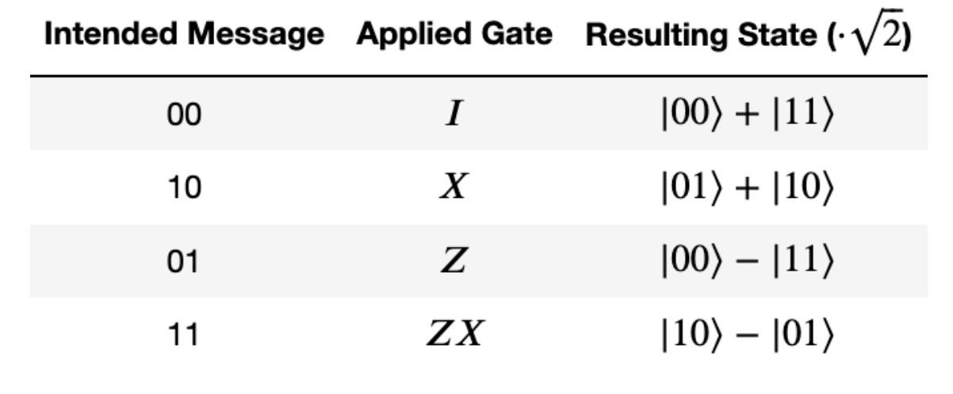
Super-Dense Coding Continued
Step 1: A third party entangles two qubits and sends one to Alice and the other to Bob
Step 2: Alice receives qubit and applies gates to her qubit depending on what two classical bits she wants to encode

Slide 5
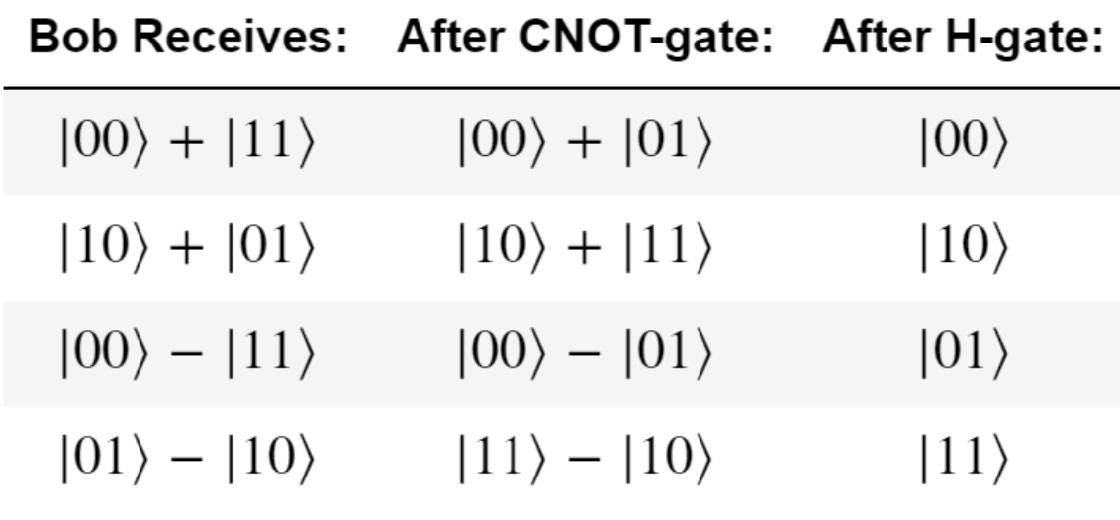
Super-Dense Coding Continued
Step 3: Alice sends her encoded qubit to Bob
Step 4: Bob receives the qubit and applies A CNOT gate with Alice’s qubit as the control and Bob’s qubit as the target, then applies a Hadamard gate and measures both qubits to receive Alice’s message

Slide 6
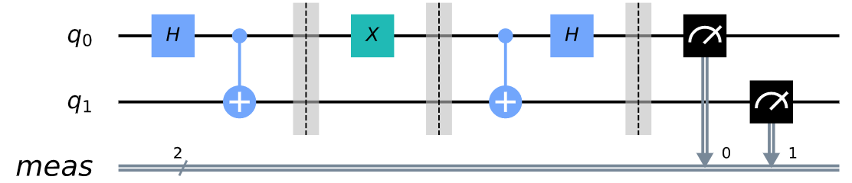
Super-Dense Coding circuit
Entanglement
Alice’s encoding
Bob’s restoration
Measurement

Slide 7

Deutsch-Jozsa Algorithm
**One of the first quantum algorithms that was shown to perform better than classical algorithms.**
Problem:
f(x) is a boolean function that is guaranteed to either be:
Constant: returns all 0’s or all 1’s for any input
Balanced: same number of inputs for which f(x) takes 0 and 1
Goal: Is f(x) constant or balanced?!
Approach: If we treat f(x) as “quantum oracle”, we can solve this problem with one measurement!

Slide 8




Start with the first n qubits in state |0> and one more qubit in state |1>
Place all qubits in superposition by applying Hadamard gates.
Apply the “quantum oracle”
The first n-qubits are control qubits, last qubit is target:
APPLY CNOT
Apply Hadamard gates again to the first n-qubits.
Measure the first n-qubits
Addition mod 2 ↔ XOR

Slide 9
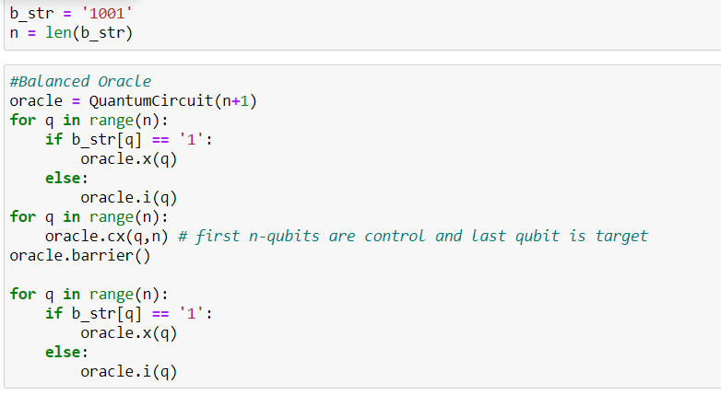
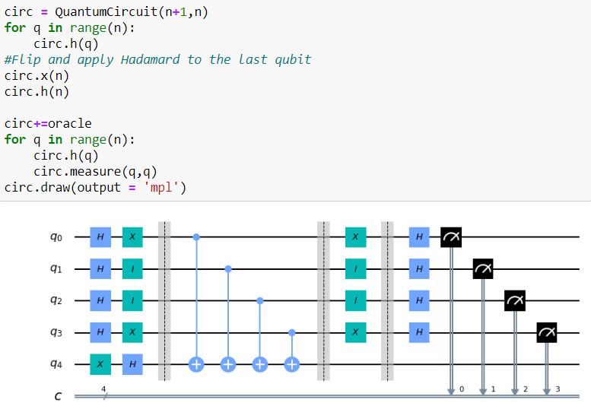
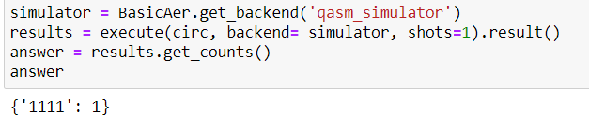

Slide 10

Bernstein-Varazani Algorithm
An extension of Deutsch-Josza problem.
Given an input x:
Goal: Find s, the bit-string
Multiplication Mod 2

Slide 11
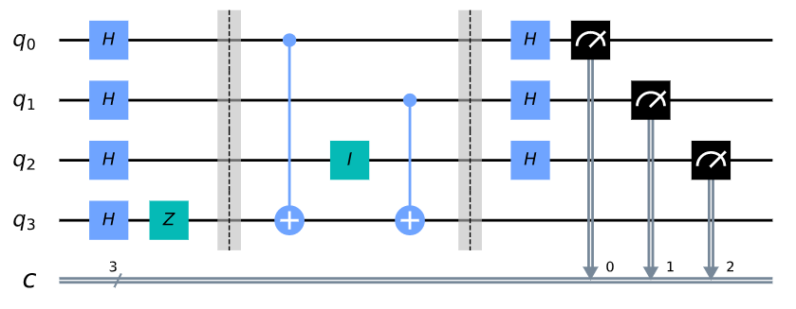
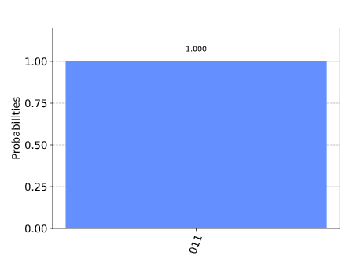
S = ‘011’

